Slide 1
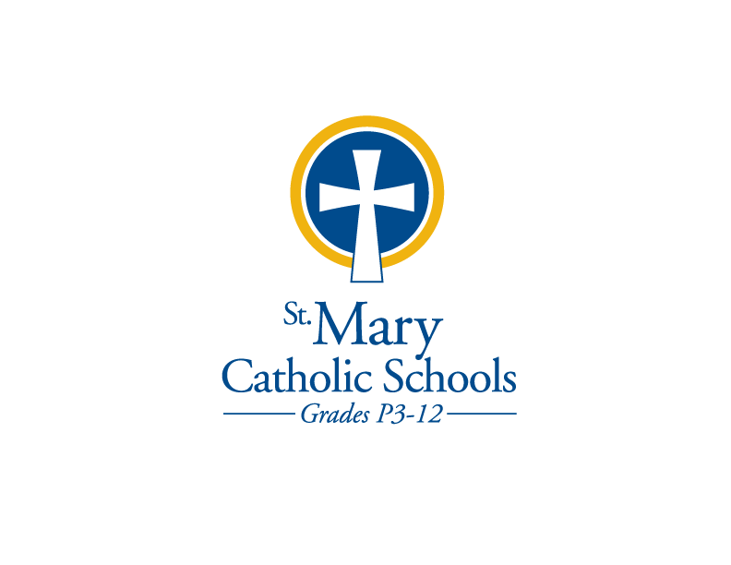
WELCOME

Slide 2
Remembering our loved ones ………
Welcome to our celebration mass of All Saints Day and Remembering our Loved Ones. As a school community, we warmly welcome the family members and friends of those who have passed to eternal life since last November.
At this time, I invite one representative from each of our guest families to come forward, pick up a candle and assemble in the back.
Today, let us continue to be grateful for God’s blessings and the memories of those we hold in our hearts.

Slide 3
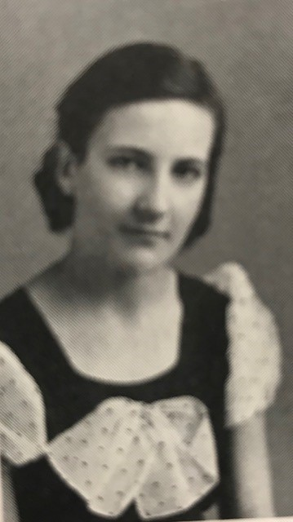
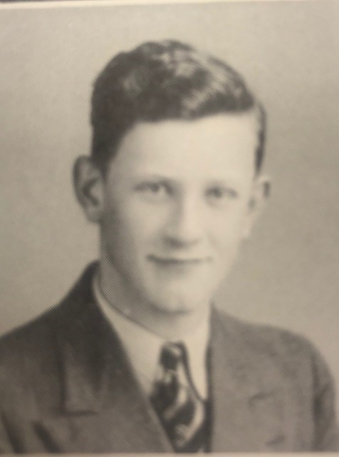
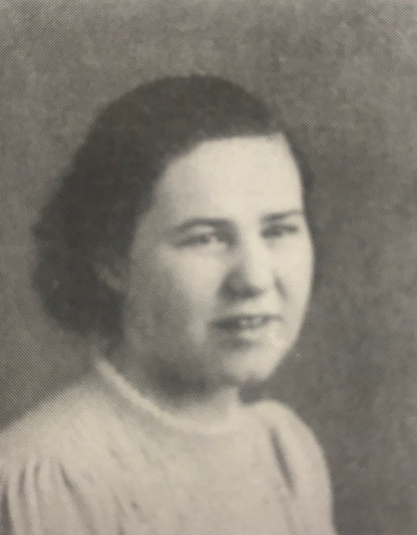
Remembering our loved ones ………
Class of 1934
Class of 1939
Class of 1939
Virginia Schommer Lippert
Thomas Collins
Helen Metz Rooyakkers

Slide 4
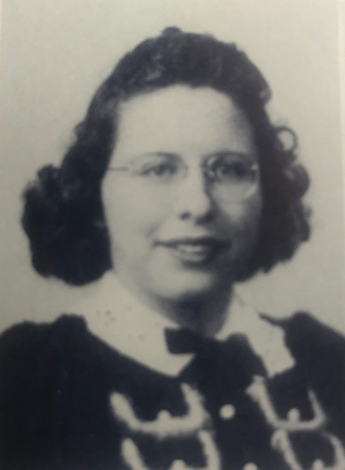
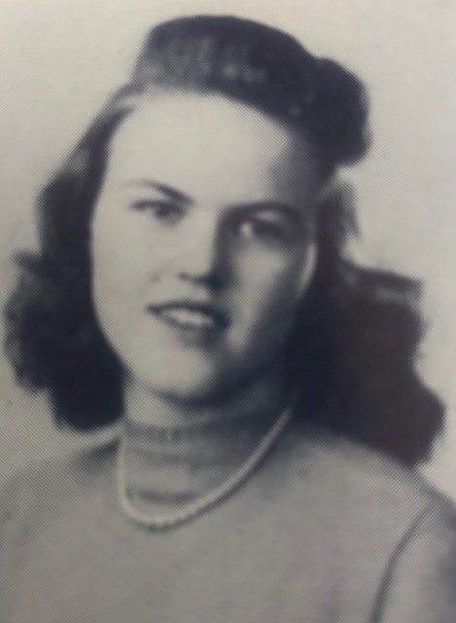
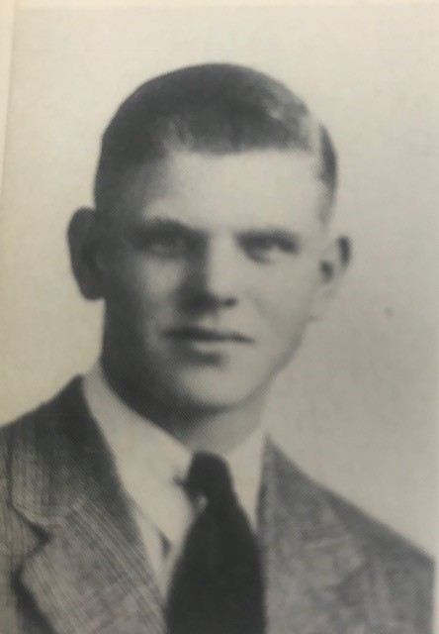
Remembering our loved ones ………
Class of 1942
Class of 1942
Class of 1944
Joyce Massey Stafford
Delores Altenhofen VanDrunen
Richard Huelsbeck

Slide 5
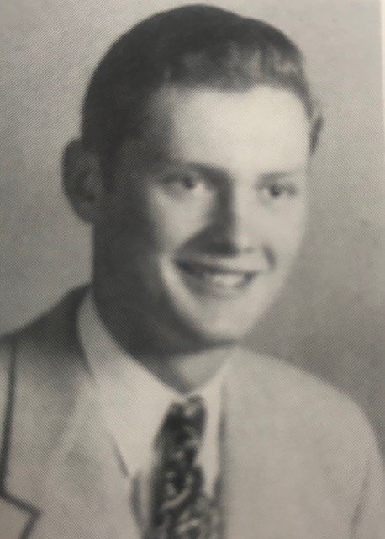
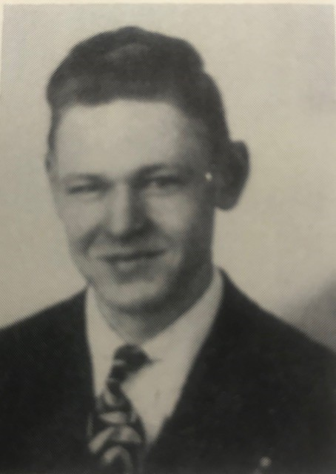
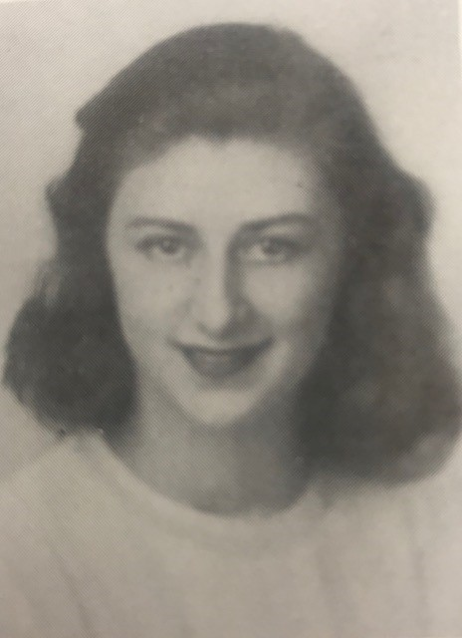
Remembering our loved ones ………
Class of 1946
Class of 1946
Class of 1946
Richard Bauer, Sr.
Marvin Jacobs
Lillian Suess Sambs

Slide 6
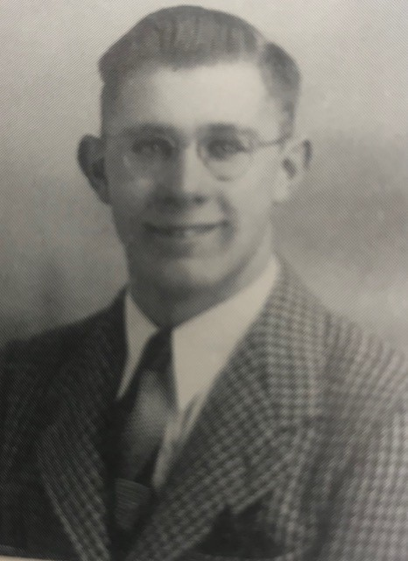
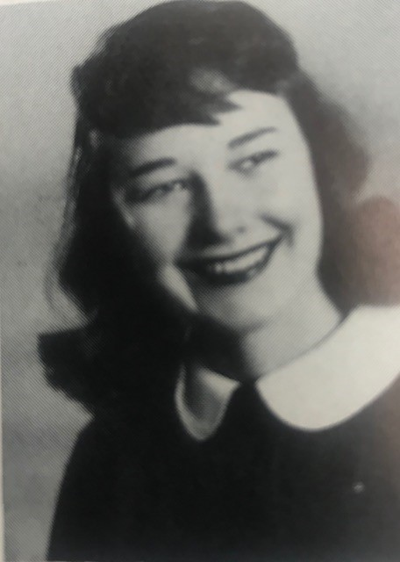
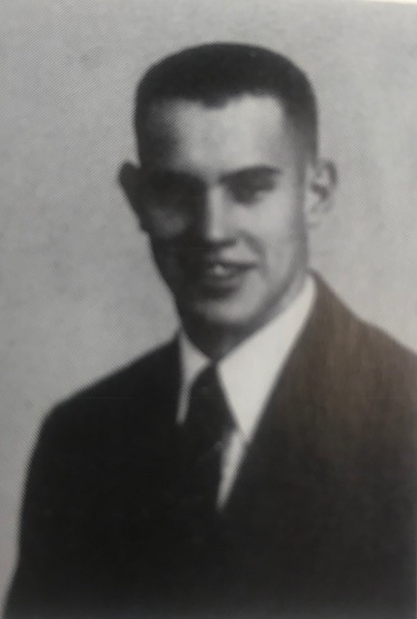
Remembering our loved ones ………
Class of 1946
Class of 1948
Class of 1949
Lawrence Ulrich
Joan Schultz Arft
Jerrold Lotzer

Slide 7
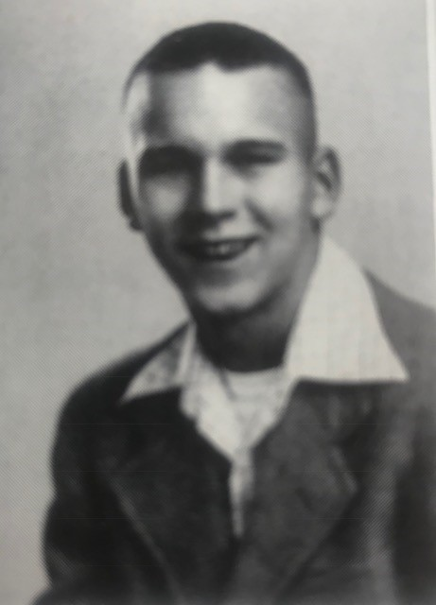
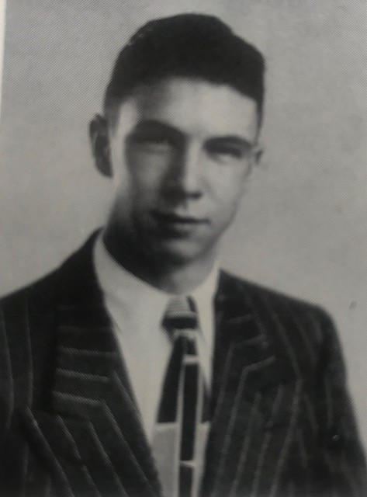
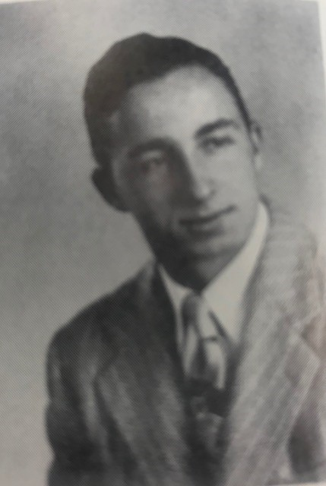
Remembering our loved ones ………
Class of 1949
Class of 1949
Class of 1949
Ambrose Magalski
Dr. Jerome Riese
Paul Zimmer

Slide 8
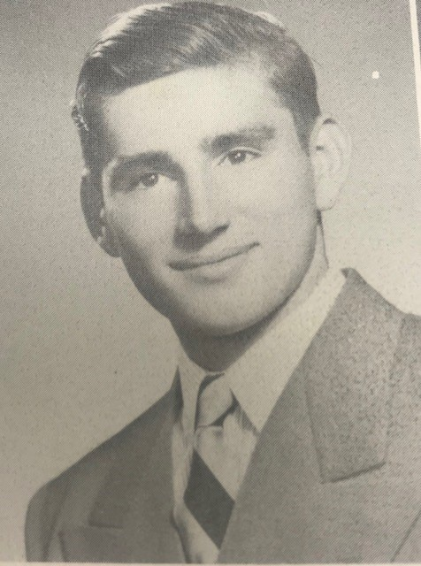
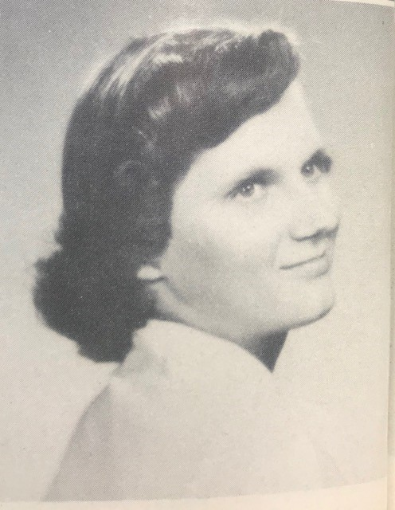
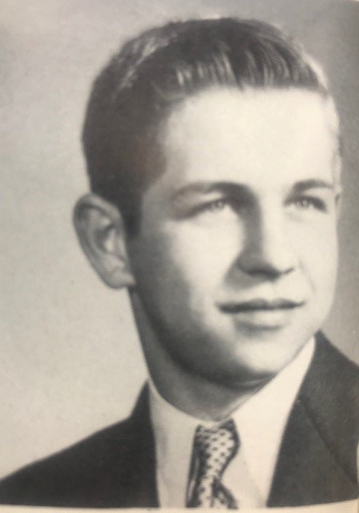
Remembering our loved ones ………
Class of 1951
Class of 1952
Class of 1952
Donald Stoegbauer
Marcene Kropidlowski Last
Frank Muehlenbein

Slide 9
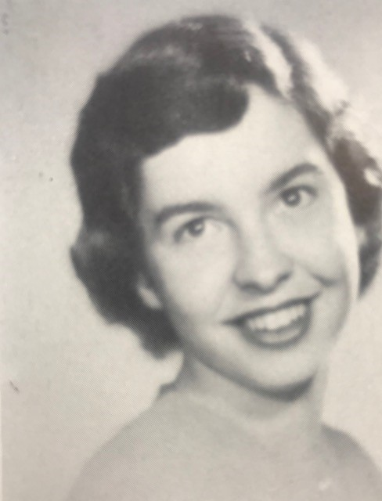
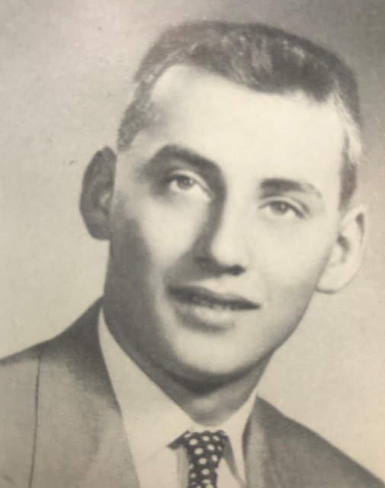
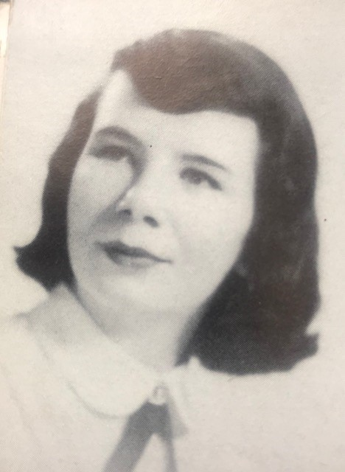
Remembering our loved ones ………
Class of 1952
Class of 1952
Class of 1953
Joan Pawer Wright
Paul Zelinski
Anne Corry-Strasma

Slide 10
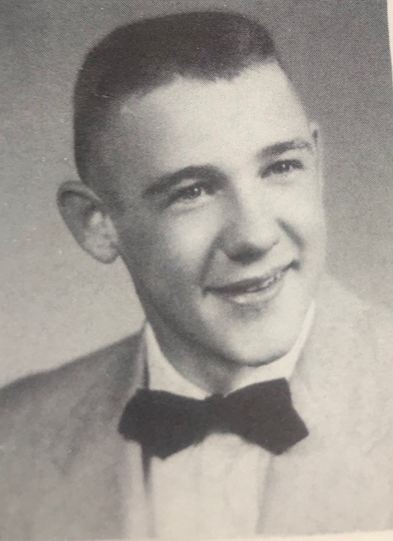
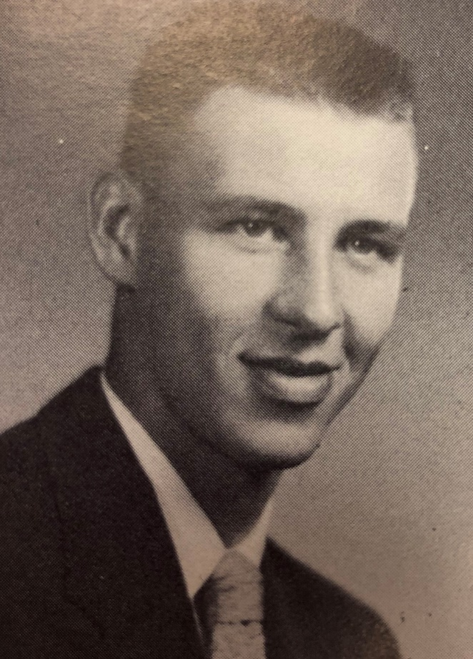
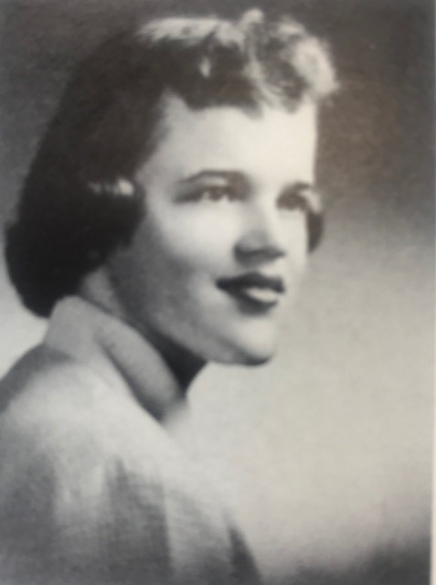
Remembering our loved ones ………
Class of 1955
Class of 1955
Class of 1955
Herb Batley
James Destiche
Helen Hoffman Knuijt

Slide 11
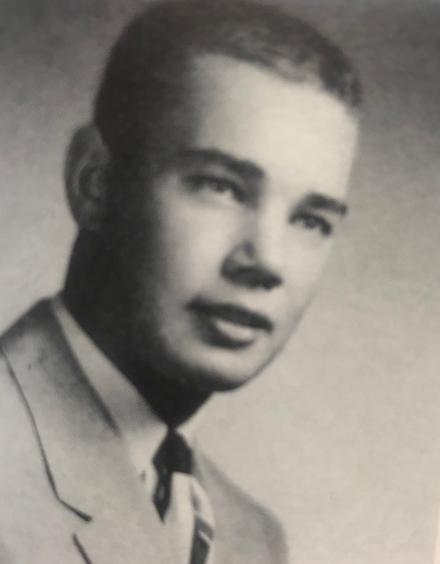
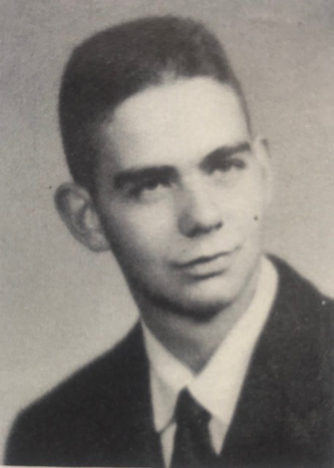
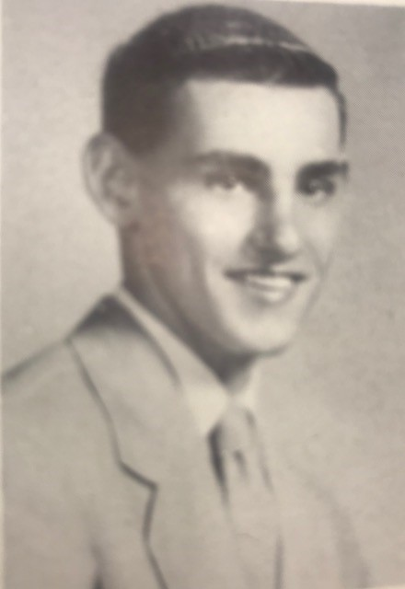
Remembering our loved ones ………
Class of 1955
Class of 1956
Class of 1957
Peter Peterson
John Bauernfeind
Ronald LaCount

Slide 12
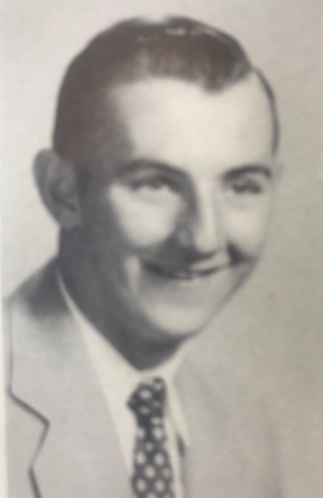
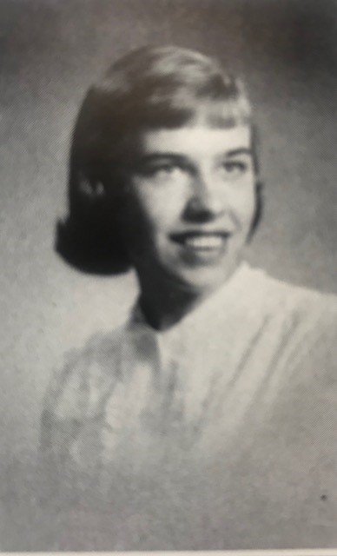
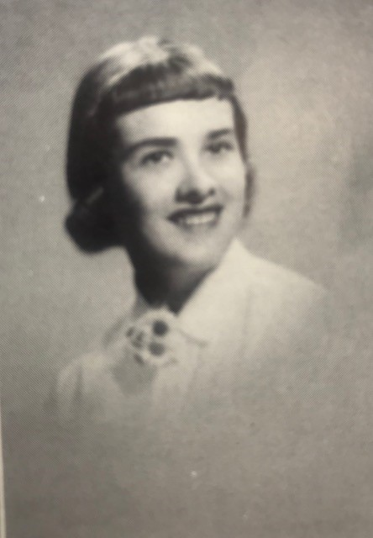
Remembering our loved ones ………
Class of 1957
Class of 1958
Class of 1958
Clarence Lotzer, Jr.
Bernice Viotto Malchow
Suzanne Hett Roebke

Slide 13
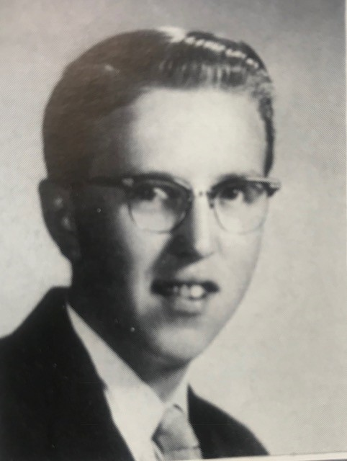
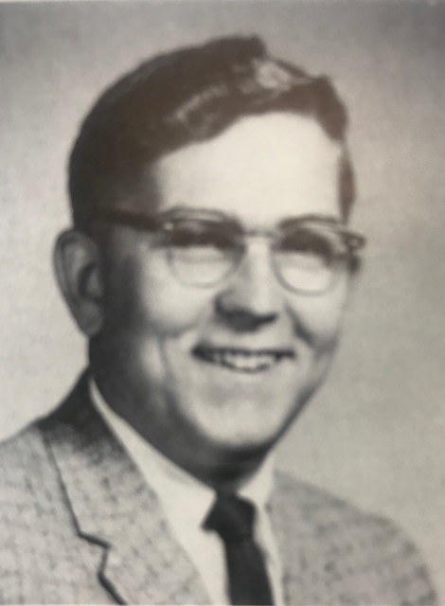
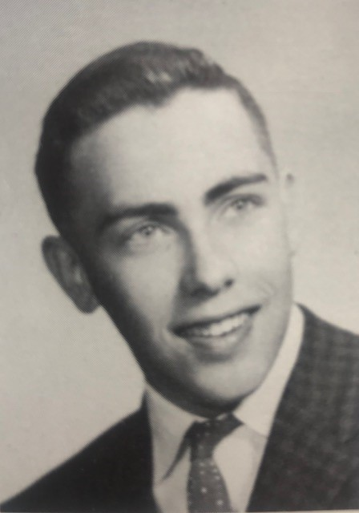
Remembering our loved ones ………
Class of 1959
Class of 1959
Class of 1959
Robert LeRoux
Fredrick Sewall
Ken Zettel

Slide 14
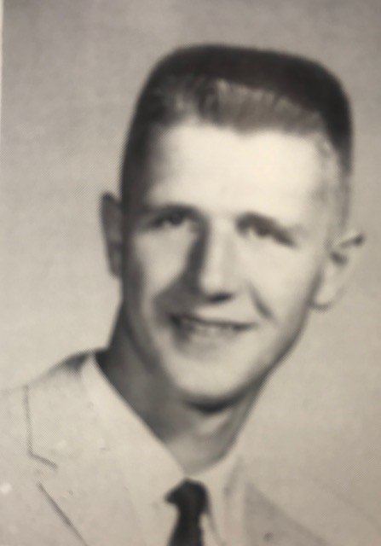
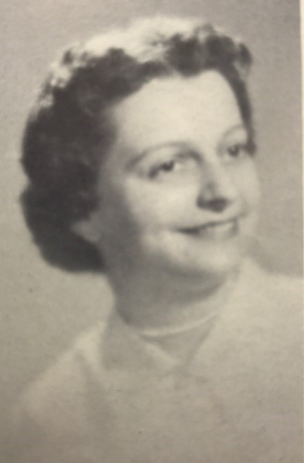
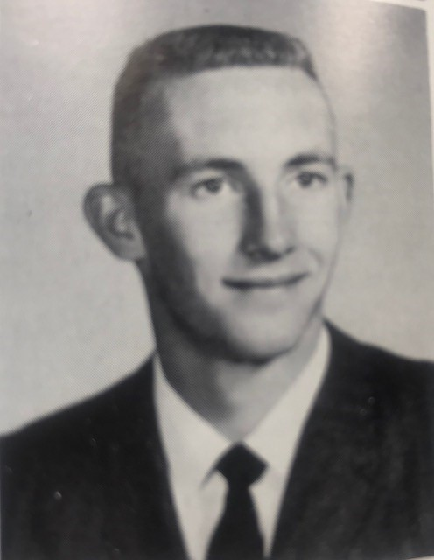
Remembering our loved ones ………
Class of 1960
Class of 1960
Class of 1960
Thomas Meier
Helen Hackstock Quigley
James Rueckl

Slide 15
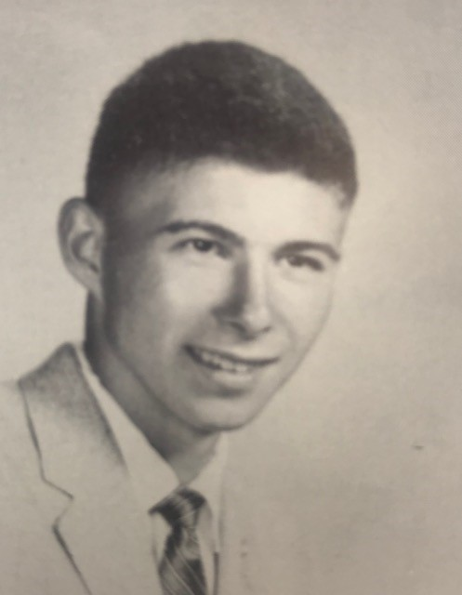
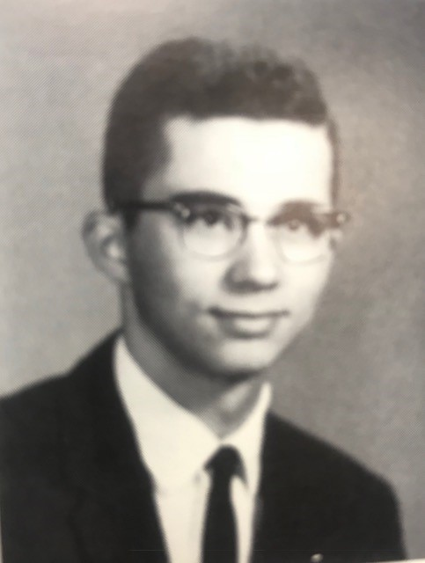
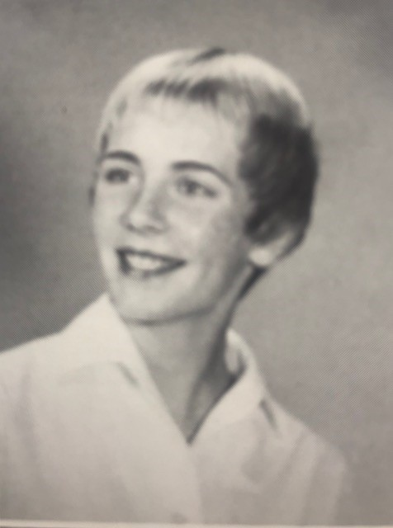
Remembering our loved ones ………
Class of 1960
Class of 1961
Class of 1961
William Simon
John Kober
Karen Meyer Stenson

Slide 16
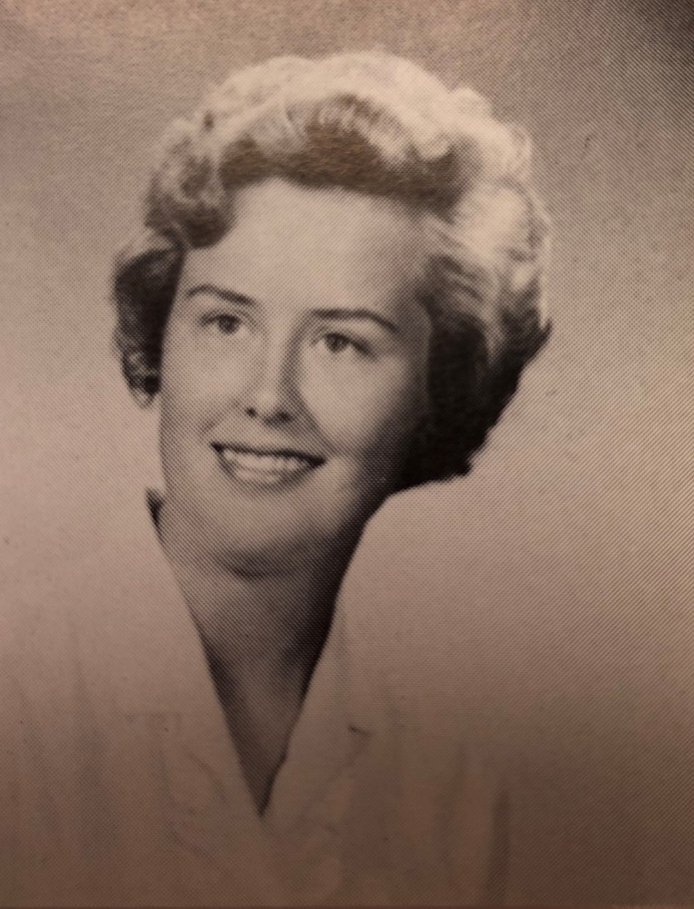
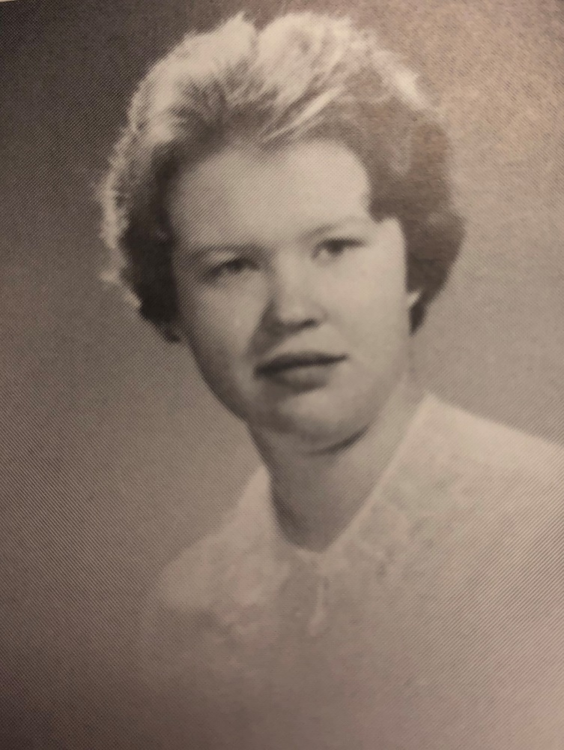
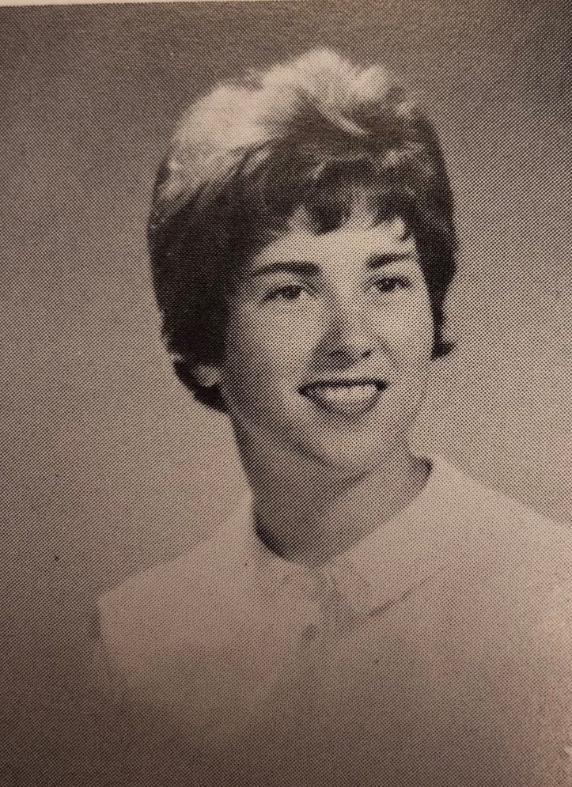
Remembering our loved ones ………
Class of 1962
Class of 1963
Class of 1963
Barbara Schmidt Luebke
Joanne Flemming
Helen Fink Forbeck

Slide 17
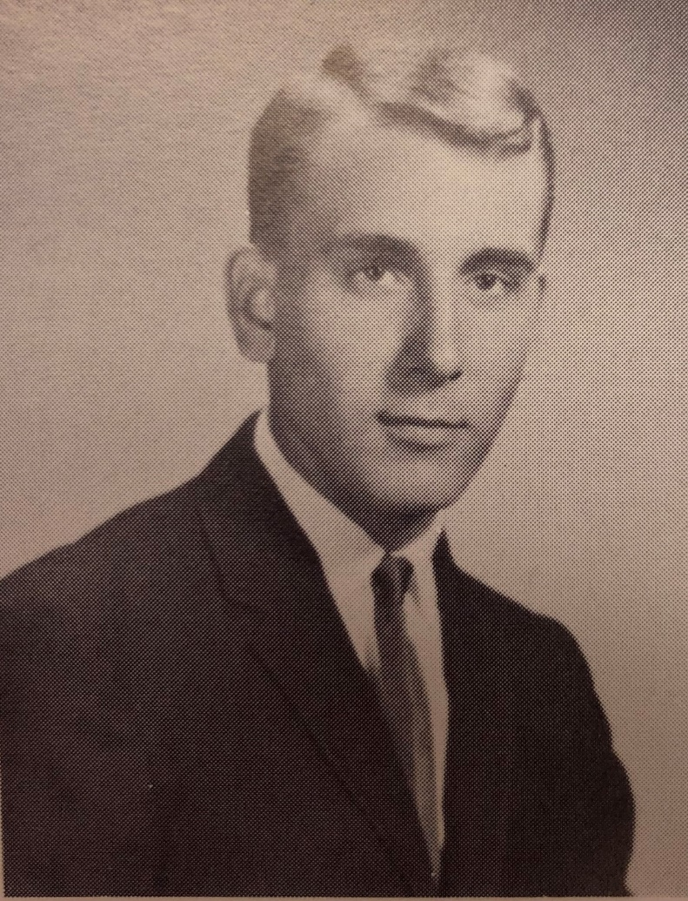
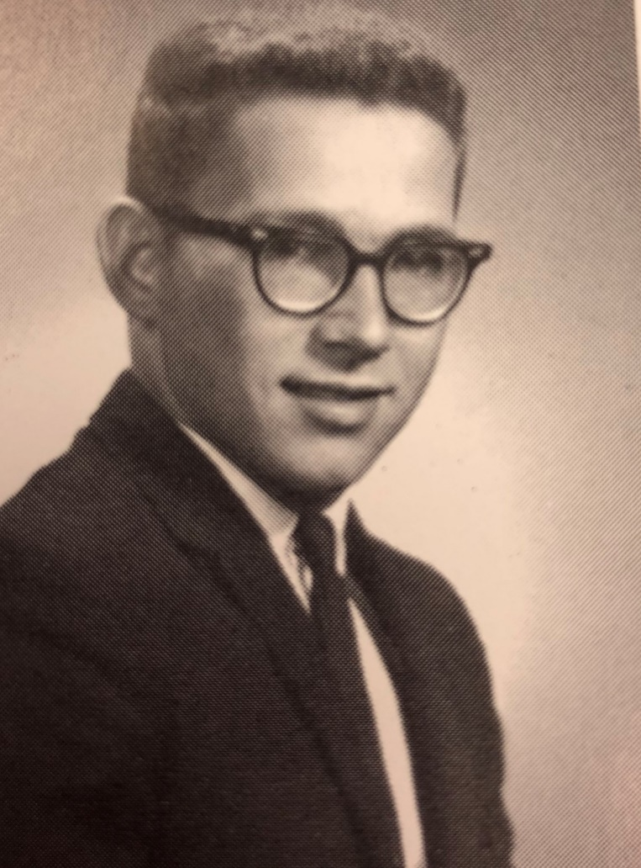
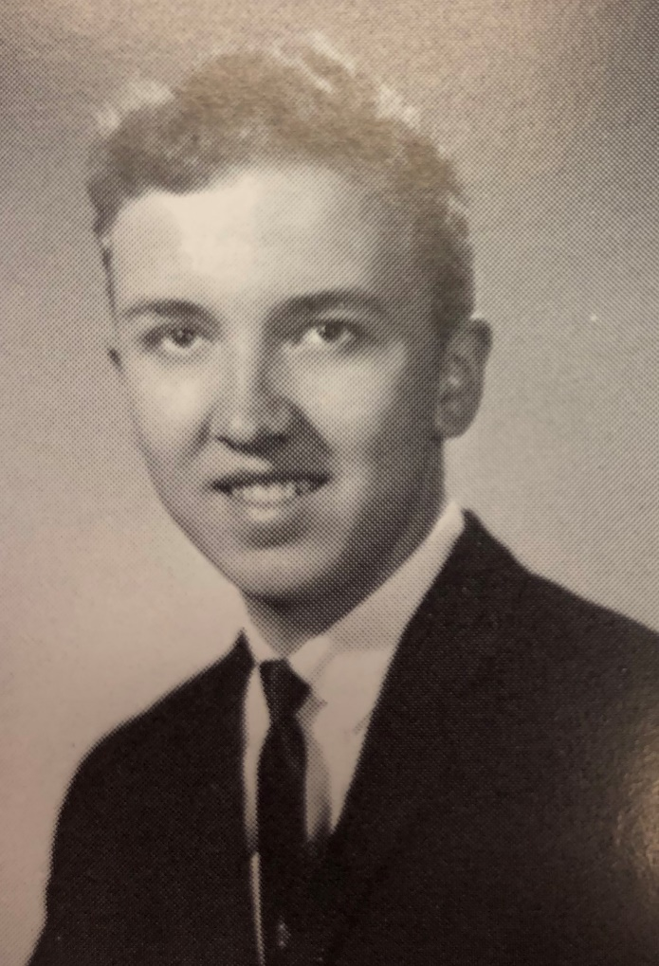
Remembering our loved ones ………
Class of 1963
Class of 1965
Class of 1965
Thomas Johnson
Charles Babbitts
Frank Rippl

Slide 18
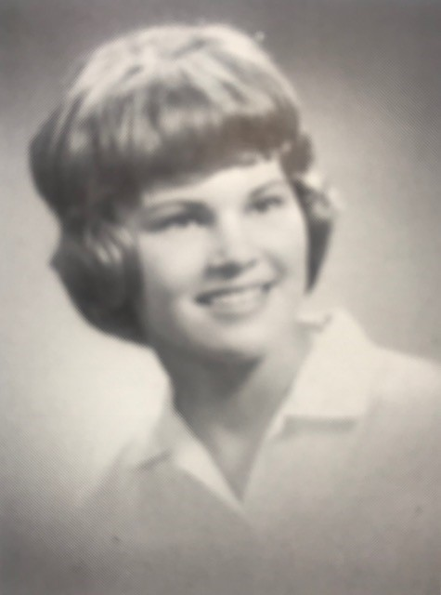
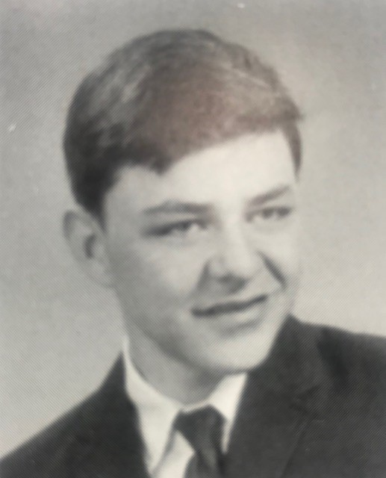
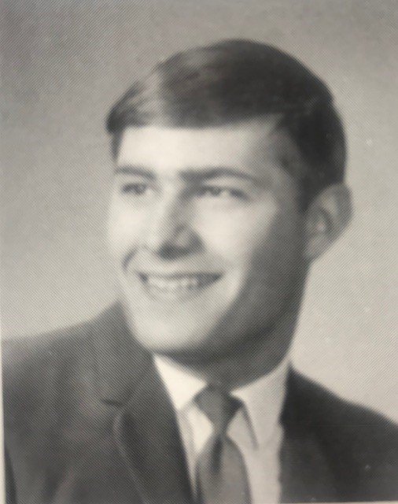
Remembering our loved ones ………
Class of 1966
Class of 1967
Class of 1967
Patricia Weber Wilcomb
Thomas Kaeser
David Thiede

Slide 19
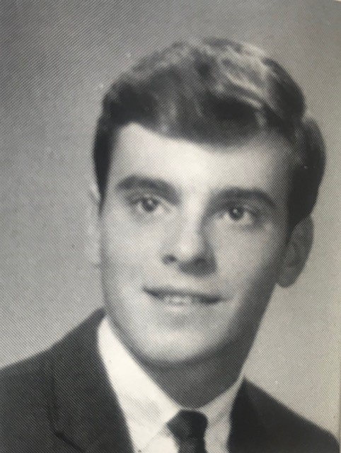
Remembering our loved ones ………
Class of 1967
Class of 1970
Class of 1970
Mark Zahringer
George Koller
George Rohe

Slide 20
Remembering our loved ones ………
Class of 1971
Class of 1973
Class of 1979
Jean Hopfensperger Gross
Carol Chouinard
Colleen McMahon Albani

Slide 21
Remembering our loved ones ………
Class of 1981
Honorary Alumni
Diana Wirth Matson
Michael Heideman

Slide 22
Remembering our loved ones ………
FRIENDS AND FAMILY OF ST. MARY CATHOLIC SCHOOLS
Mary Jo Aerts
Reine Albrecht
David Benkowski
Ronald Benz
Agnes Blaski
Geraldine Bliesner
Sara Bruskiewicz
Julia Buerck
Cathryn Burdge
Christian Costello
Kathy DeWitt
Jean Foord
Dr. Thomas Fuller
Georgiana Gallucci
Beverly Garland
Rita Griffin
Abby Herbert
Raque Hernandez
Edward M. Jekot
Shirley Kabat
Tyler Keohn
John Koehler
Barbara J. Koehn
James Kranenbuhl
Jevon Lemke
Paul Joseph Lingg
Lawrence London
Brenda Marquardt
Jack Marquis
Donn Marshall
Donna Martin
Margaret Meyer
Daniel Robert Needham
Sue Niesen
Wyatt Olson
Rosemary Ott
Mal Petit
Kennedy Pfeffer
Marie Ritger
Travis Schara
Brian Shelton
Mary Shelton
Lorraine Srnka
Jeff Staddler
Jim Taylor
Antonious Vanden Acker
James Viotto
Rita Weinmann
Steve Wideman
Joan Will
Dale Winkler
James Wood

Slide 23
Remembering our loved ones ………
Eternal rest grant unto them, O Lord and let perpetual light shine on them. Amen

