Slide 1
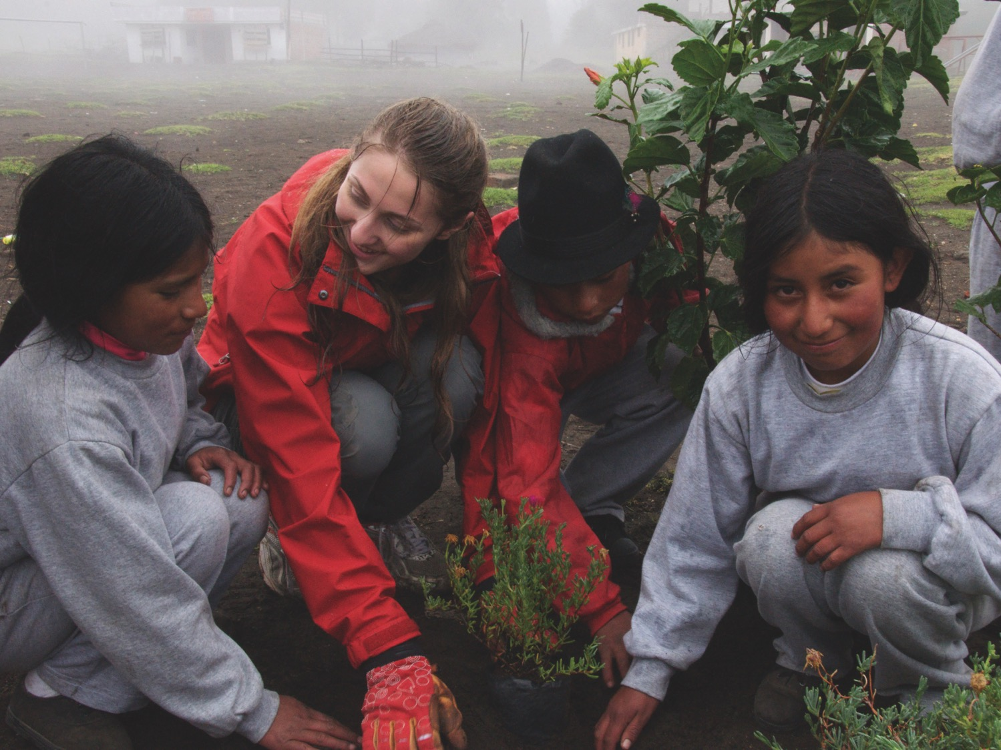
Environmental Citizenship in
the Dominican Republic
¡BIENVENIDOS!

Slide 2

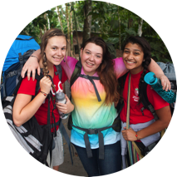

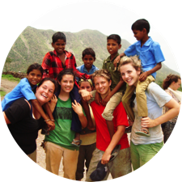
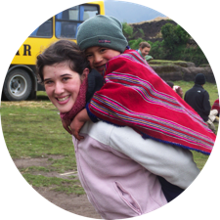

OUR MEETING WILL COVER
Why travel is important
Where we’re going and
what we’ll be doing
Our travel partner
The safety approach
What’s included and
what’s not
How to reserve your spot

Slide 3

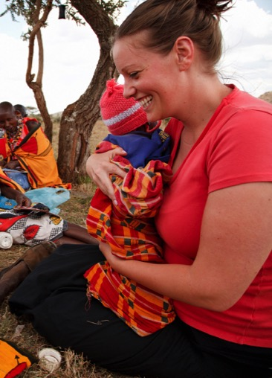
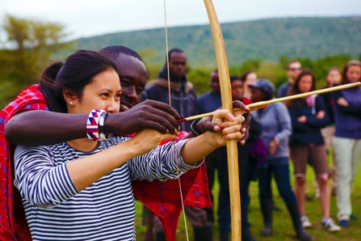

WHY TRAVEL?
When applying for colleges, a service trip abroad really makes you stand out.
Helps students to become open minded towards other cultures and ideas.
Helping students become global citizens
“This trip is definitely a highlight of my high school career. It has changed my perspective about the things that I take for granted daily in the U.S and I am forever grateful for these memories and moments.”
— Arianna F., Student
Watch the video

Slide 4

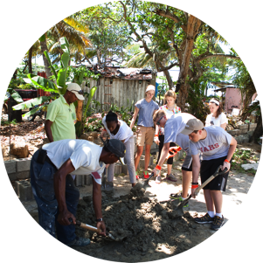

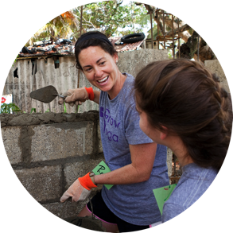
WHAT TO EXPECT ON A SERVICE LEARNING TOUR
Meaningful
Service
Cultural
Immersion
Leadership Development

Slide 5

TOUR HIGHLIGHTS
Highlights from our Itinerary! What are some of YOUR favorite things in the itinerary?
Brave the rapids on a white water rafting trip or go on a waterfall hike. Take a guided tour of a national marine park, and snorkel your way around the turquoise waters.
Try your Spanish with locals.
Learn Bachata and Merengue, two popular Dominican dances
Work side by side with locals. Promote responsible tourism to help support local economy and conservation efforts. Plant community gardens to improve food security.

Slide 6
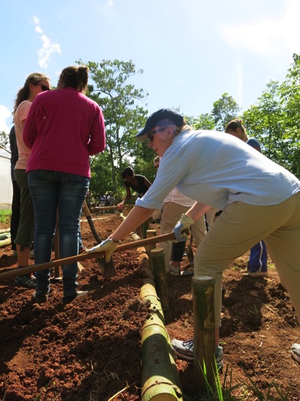
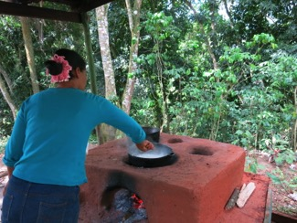
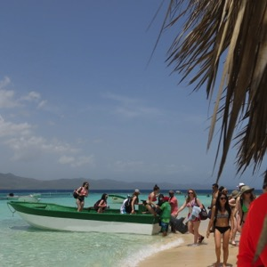
A LOOK AT A DAY ON TOUR
Dominican Republic
Morning
Enjoy a regional-style breakfast.
Begin your environmentally focused service project in a nearby village
Afternoon
Grab a traditional lunch of rice and beans.
Immerse yourself in cultural activities
Evening
Participate in a conversation about how someone's circumstances influence his or her opportunities in life.
Before bed, reflect on the day and write your thoughts in your EF Field Journal.

Slide 7
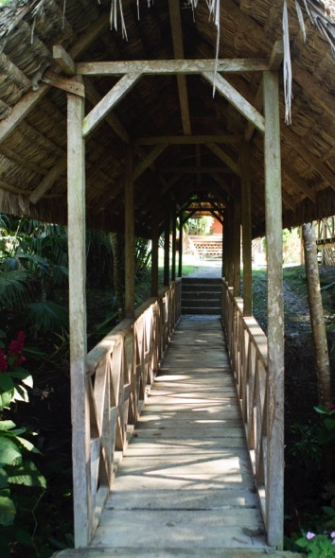
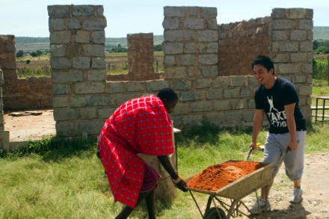

A MORE ENGAGING
LEARNING EXPERIENCE
Bring classroom subjects, people and
places to life.
Promote our shared humanity through meaningful reflection and sustainable service.
Strengthen voice and empower you to affect change both at home and abroad.
Develop new perspectives that will give students an edge on their college applications (and in the college lecture hall).
“I watched my students, who have always found a need for more things, learn to rely on less; learn to use what they have and adapt; to not take anything for granted.”
— Aimee L., Group Leader

Slide 8
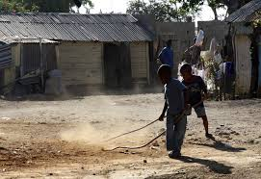
Sample projects and current DR challenges
Challenges
  40% of the population lives below the poverty line
  Most children only spend 3-4 hours a day in school
  Approximately half of all schools don’t have access to safe drinking water
What our nonprofits are doing there now
  For Education
    Tutoring students in English
    Running health/wellness related activities for students
  For the Environment
    Planting seeds
    Removing invasive species
    Creating environmentally friendly community recreation areas by building benches, pathways, and tent platforms
    Improving community gardens or composting
  For Community Development
    Constructing hand washing stations/latrines
    Buildings and restoring fences/walls around schools/playgrounds/public areas
    Building community gardens

Slide 9
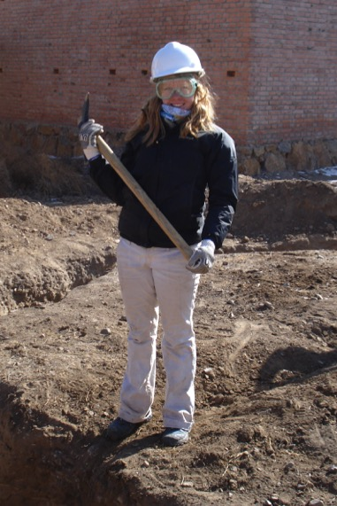


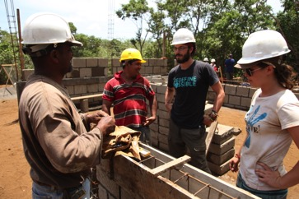
WHY EF?
50 years of experience
Global and local presence
  Over 500 schools and offices in over 53 countries
  Partnerships with local non-profits
Educational value
  Accredited, just like our school
  Earn high school and college credit
Incredible travel experiences at the guaranteed lowest price
“My department has
been traveling with EF for over 20 years!”
— Heather V., Group Leader

Slide 10
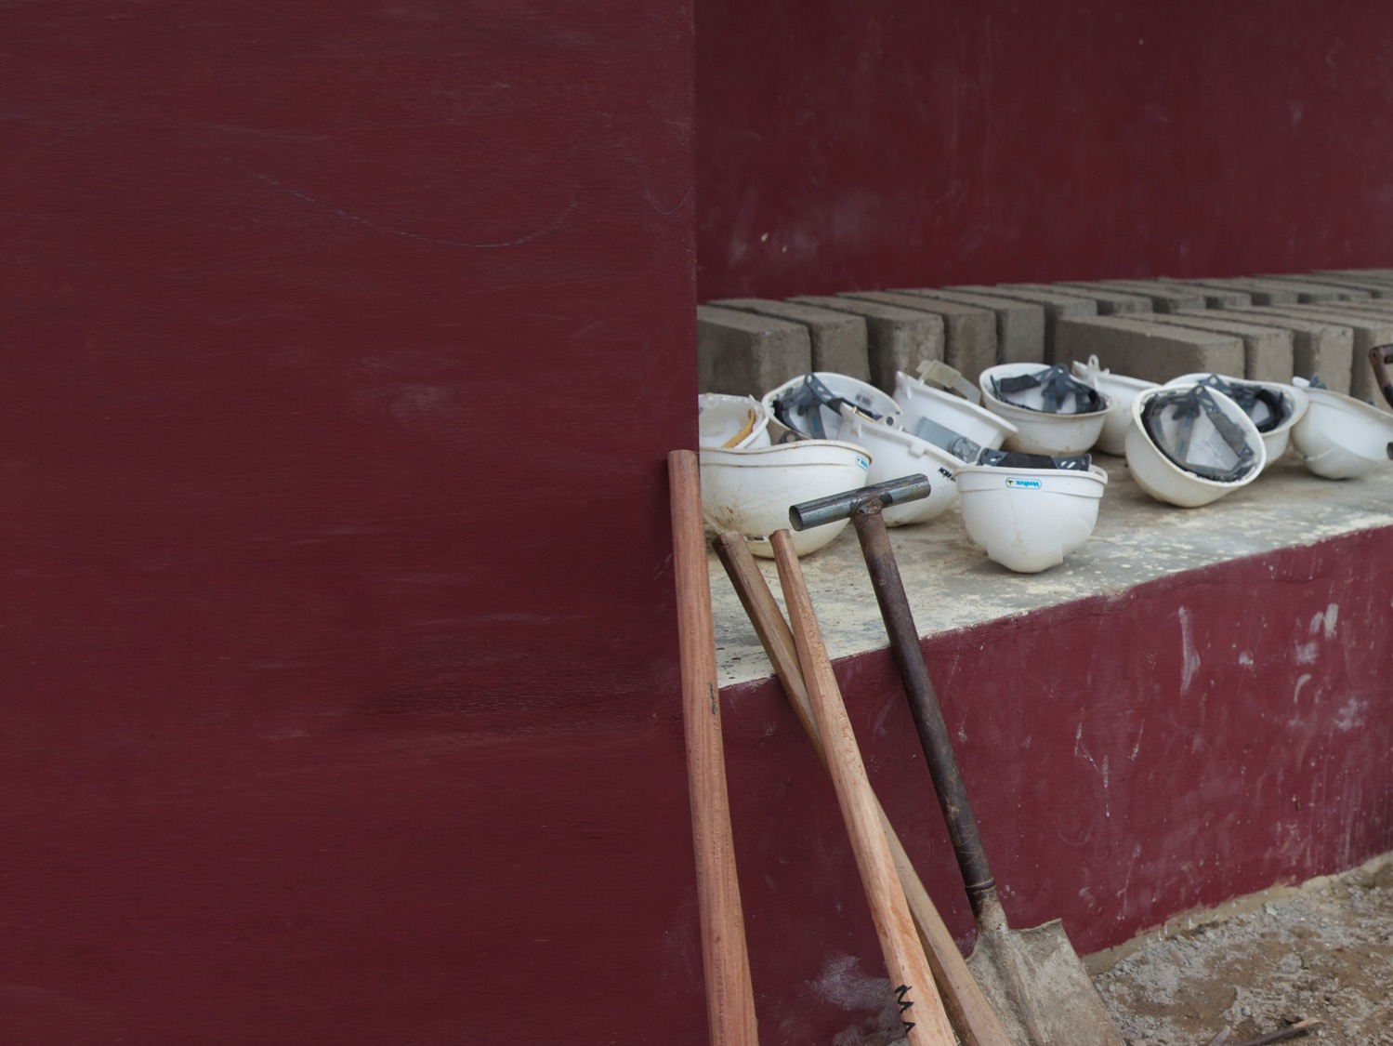
EF’S COMMITMENT TO
OUR SAFETY
24/7 Field Director
Chaperones
24-Hour emergency on-call service
Peace of Mind policy
My approach to safety

Slide 11
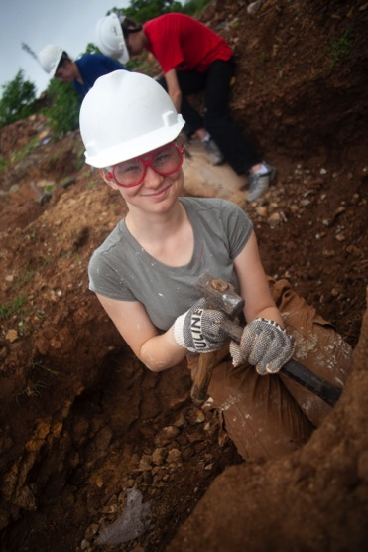
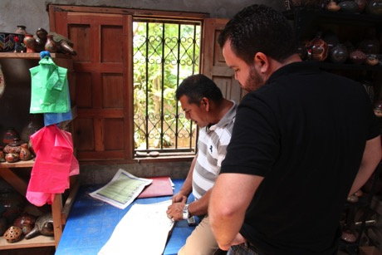
WHY GROUP TRAVEL?
Group travel keeps tours affordable, allowing more students to see the world
“This trip did so much for the students and adults alike—opened doors, broaden horizons, changed perspectives!”
— Shannon M., Group Leader
Combined groups get the best value.
Tour choice and departure date flexibility to match with other groups.
Meet other students from around the country.
Our departure date window is:
06/08/17 – 06/16/17

Slide 12

THE GLOBAL
TRAVEL PROTECTION
PLAN COVERS:
Tour cancellation and interruption
Illness and accident
Baggage and property
Flight delay
24-hour access to an English-
speaking representative

Slide 13
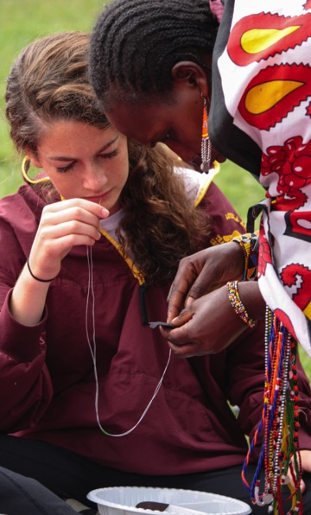
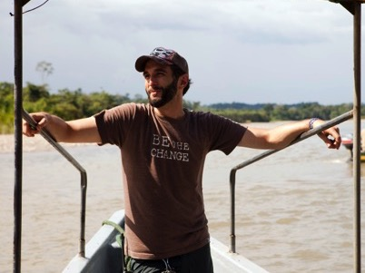
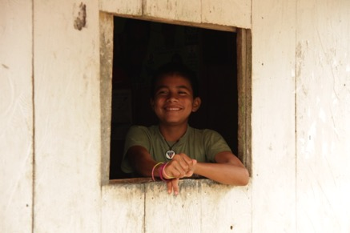
WHAT ARE YOU
RESPONSIBLE FOR?
These are all necessities each traveler will be responsible for.
Spending money
For additional tour experiences, free time activities, souvenirs, beverages, and snacks ($15–$30 per day)
Tips
For your Field Director, bus driver and local guides
Appropriate clothing for service project work
Passport and/or visa fees
Baggage fees
“

Slide 14
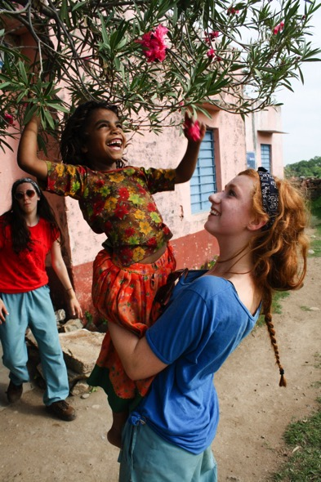
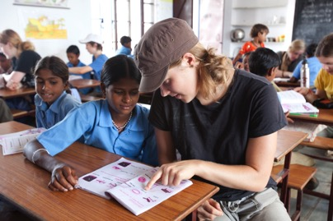
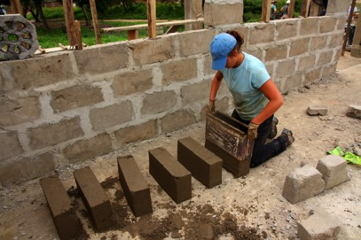
PASSPORTS AND VISAS
All travelers are responsible for securing necessary documentation
Passports
Valid passports are required for all travelers. Passports may take up to 14 weeks to process.
Important Note: Passports must be valid for at least six months after our return date.
Visas
Non-U.S. citizens may require special visas or other travel documents.

Slide 15


EVERYTHING YOU GET
Program price includes:
Round-trip flights on major carriers
Accommodations
Ground transportation
Educational itinerary
Sightseeing led by licensed local guides and entrance fees to select attractions
Full-time Field Director
Service hours that count toward academic credit
Sustainable service project with local organization
Leadership-building activities and workshops
Global Travel Protection Plan
Notes:
Make sure All Inclusive Insurance is mandatory in price already!

Slide 16
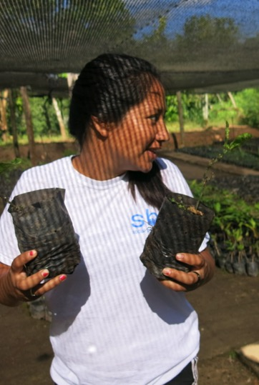
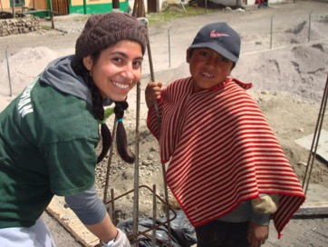
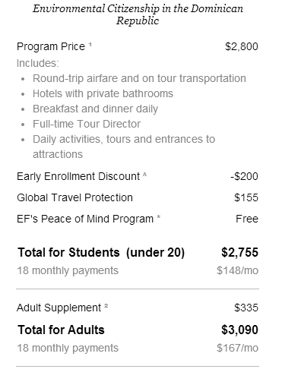
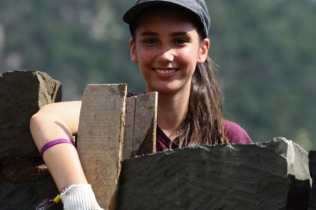
This is all without fundraising!
PAYING FOR YOUR TOUR
EF Price Guarantee—your guaranteed lowest price will never change once you enroll
, lunch and dinner
You pay:
$148 a month /
$5 a day

Slide 17

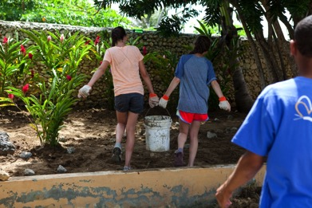

PAYMENT OPTIONS
Pay in Full at Enrollment
Pay your entire balance at the time you enroll.
Automatic Payment Plan—Free
Payments automatically deducted from your bank account – choose monthly or bi-weekly.
Manual Payment Plan—$50 Plan Fee
Receive invoices and make your payments in up to three installments.
Call Customer Service to choose your perfect plan: 800-665-5364
“In the end, our family felt our lives were changed forever by our experience. Thank you, EF Tours!”
— Lynn D., Parent

Slide 18
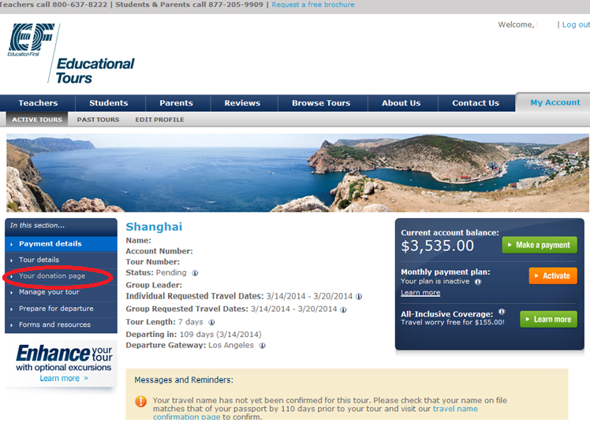

Slide 19
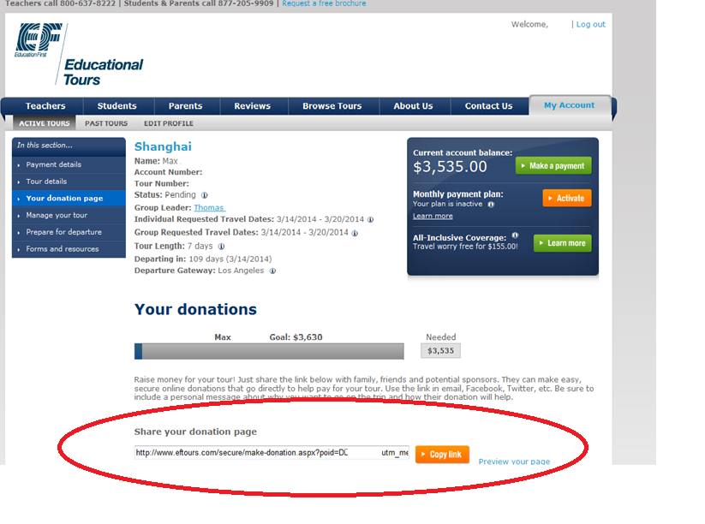

Slide 20
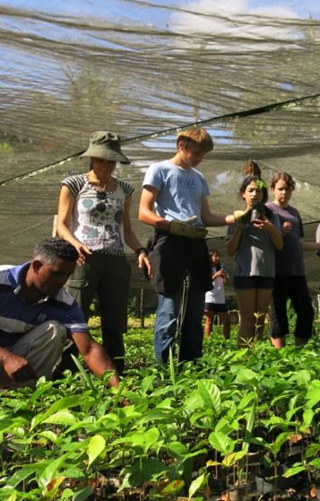
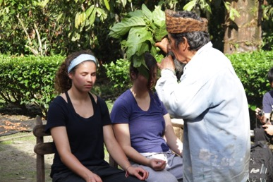


READY TO HELP?
Space is limited. Reserve your spot now!
Online:
www.eftours.com/1801340RP
Phone: 800-665-5364
Tour Number:
1801340RP
Application Deadline:
12/11/15
“It was a life-changing experience. Every moment exceeded my expectations.”
— Kathleen S., Student
First 3 students to enroll receive an extra $50 off their trip price!

